Slide 1
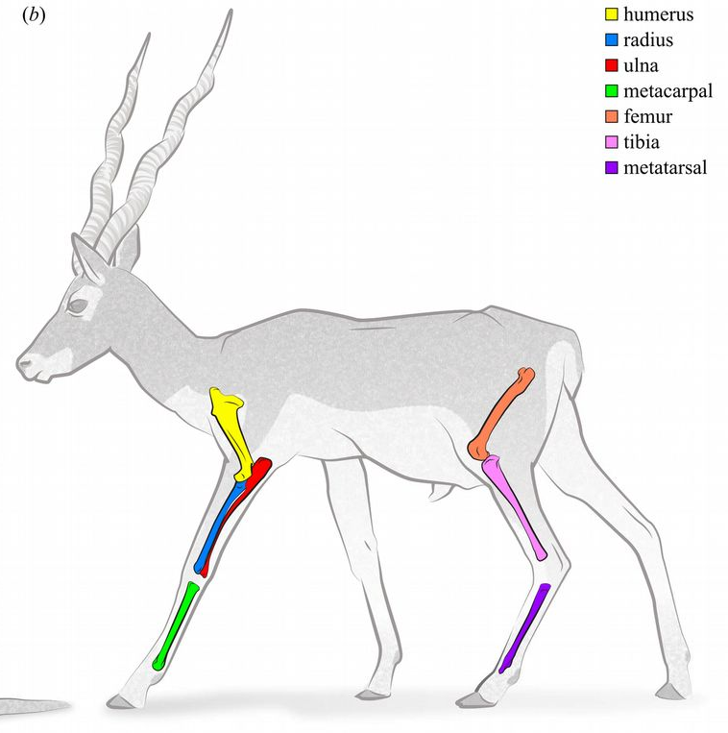
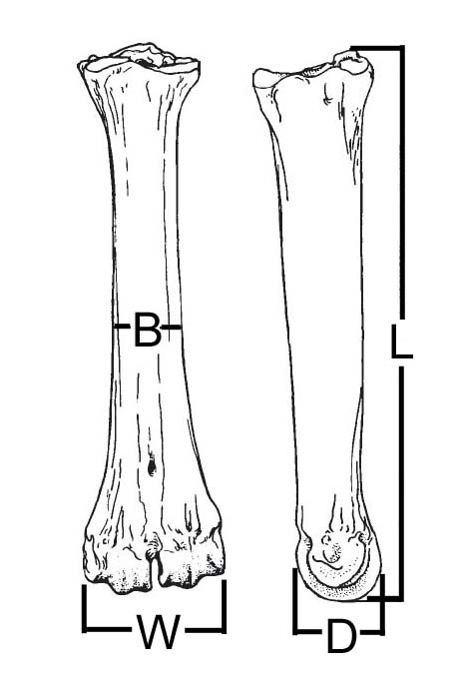
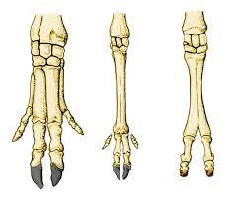
Comparative morphology of artiodactyl metacarpal bones
Humerus
Radius
Ulna
Metacarpal
Femur
Tibia
Metatarsal
Form groups of 2-3 persons with at least 1 computer connected to the internet / team
Read carefully the introduction to understand key concepts
For each task, use specimens available on the table. Only bring one specimen at a time to your table
Task 1 (metacarpal shape): Read and follow instructions, measure bone length (L) and breath (B), fill in the template excel spreadsheet and copy-paste your results (measurements + graph) in the google spreadsheet
Task 2 (Joint scaling): Read and follow instructions, measure epiphysis medio-lateral width (W) and antero-posterior diameter (D), fill in the template excel spreadsheet and copy-paste your results (measurements + graph) in the google spreadsheet
Doube et al., 2018
(articulate with hand bones)
Proximal epiphyses
Shaft
Pig
Camel
Deer
Small sheep | Large sheep | Roe deer | Red deer | Small cattle | Large cattle | Moose | Giraffe
Mu037a | Mu036a | Mu026 | Mu501 | Mu554a | Mu084 | Mu 196a | Mu101a
Mu037b | Mu036b |  |  | Mu554b |  | Mu 196b | Mu101b
Mu038a | Mu499 |  |  | Mu554c |  | Mu 196c | Mu101c
Mu038b |  |  |  | Mu554d
Distal epiphysis
(articulate with fingers)

